Slide 1


ATM Loan Analysis

Slide 2
This dataset is provided by Mitramas Infosys Global

Slide 3
Outline
Data Preprocessing
Do data transformation and cleaning in power query
Create Metrics
Do the quantitative assessment
Dashboarding
Do the visualizations for all metrics and data to easily find out the insight

Slide 4
Data Preprocessing
Data is served in excel format, The first sheet is the “SEWA ATM” dataset. I deleted the “Masa Sewa” column because it has too many null values and I don’t know which column I can use to help me fill the null values. Communication with stakeholder is very important step, since I can’t do it so I just try my best. For the Delivery column, I remove the canceled order. In the “Tanggal request” column there are some null values, but in delivery column it says that the request is delivered, so I fill the null values using the previous date. The last I unpivoted the period and “Tagihan” column.

Slide 5
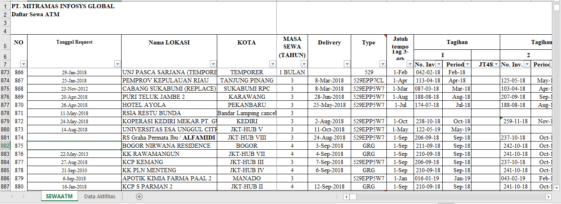
ATM Loan dataset before preprocessing

Slide 6
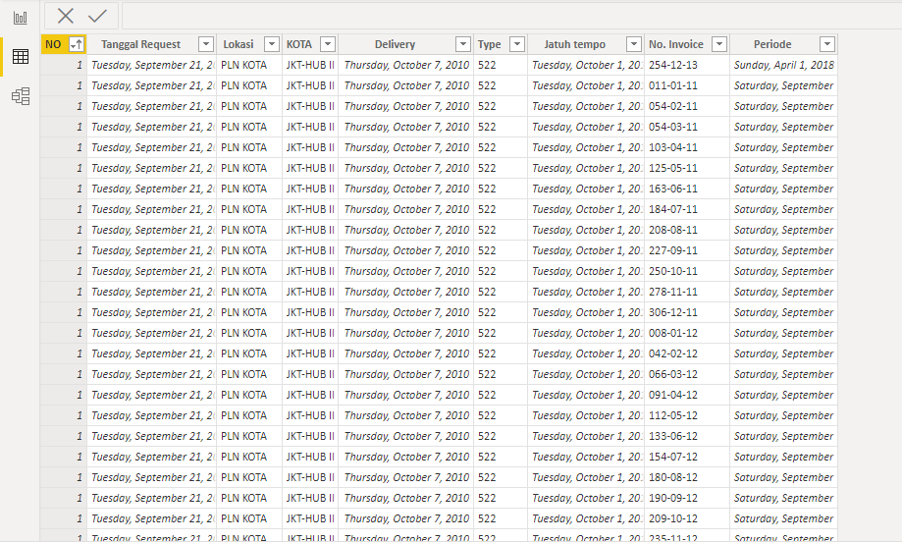
ATM Loan dataset after preprocessing

Slide 7
Data Preprocessing
The second sheet is the activity dataset. I deleted the “nomor tiket”, status and “Pilihan” columns. I simply delete columns that contain all null values.

Slide 8
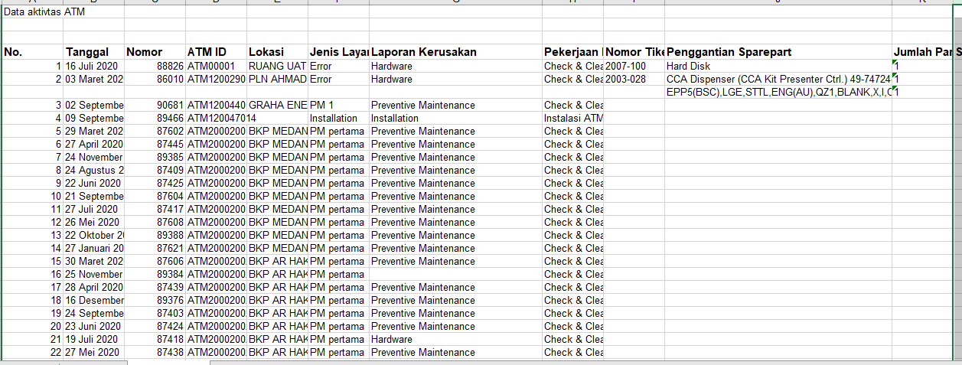
Activity dataset before preprocessing

Slide 9
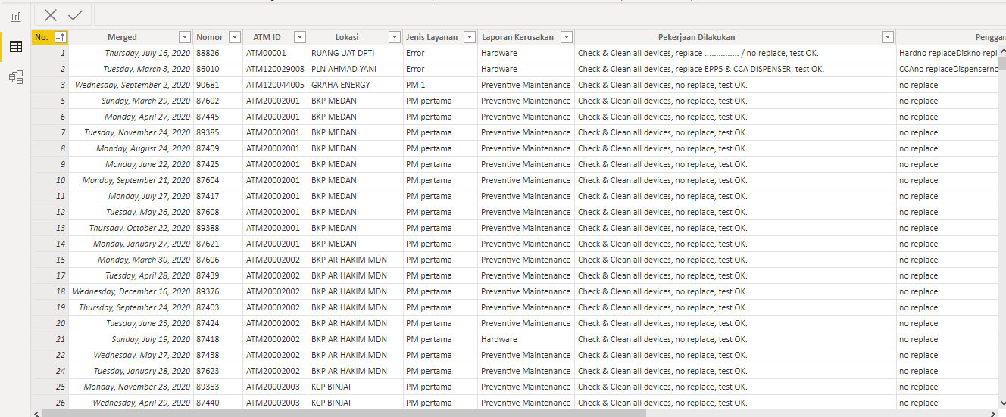
Activity dataset after preprocessing

Slide 10
Metrics
Calculated metrics to map client by city and location. See the most used ATM Type and client order by year.

Slide 11
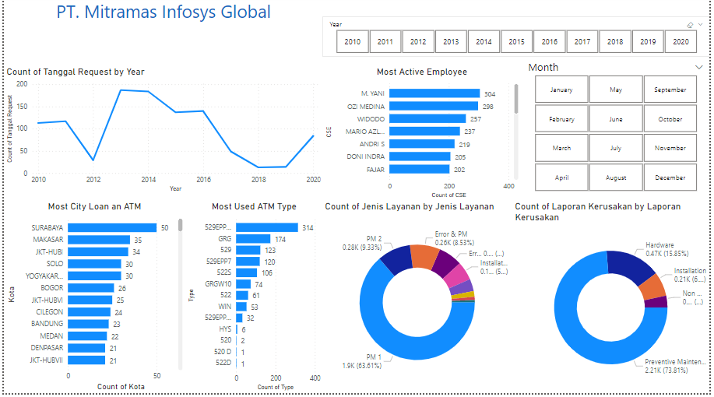
Dashboarding

